Slide 1

Recursion

Slide 2
Outline
Recursions
Types of Recursion
Computing the Nth Fibonacci Number
Problem with recursion(StackOverFlow)
Visualizing Tree Recursion
Interview Questions
Summary

Slide 3
Recursion
A method that calls itself is known as a recursive method. This process is known as recursion. A physical world example would be to place two parallel mirrors facing each other. Any object in between them would be reflected recursively.
A recursive algorithm must call itself, recursively.
A recursive algorithm must have a base condition.
A recursive algorithm must change its state and move toward the base condition.

Slide 4
Types of recursions
Direct Recursion
  Linear Recursion
    Tail Recursion
    Head Recursion
  Tree Recursion
Indirect Recursion

Slide 5
Linear Recursion
If a recursive function calling itself for one time then it’s known as Linear Recursion.

Slide 6
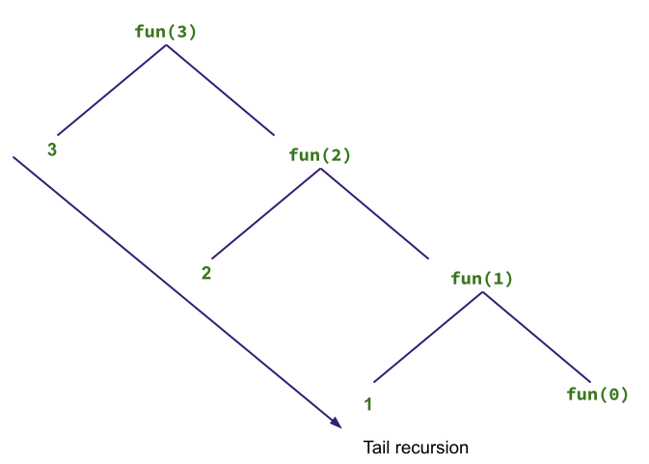
Tail Recursion

Slide 7
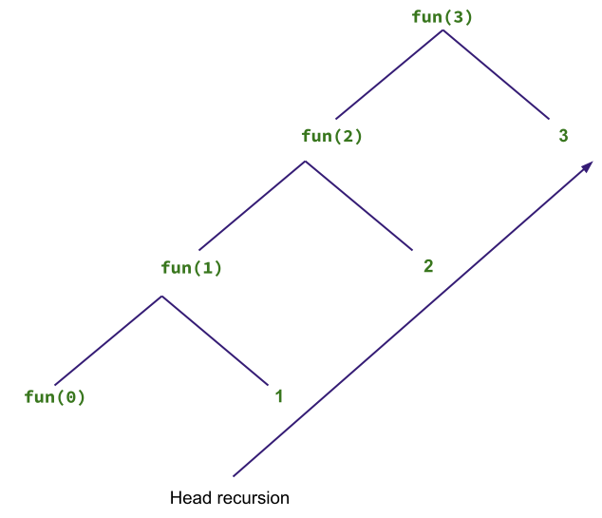
Head Recursion

Slide 8
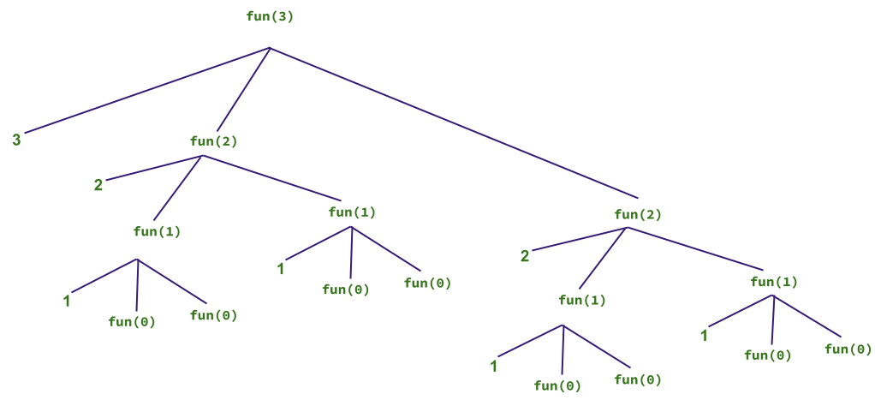
Tree Recursion
if a recursive function calling itself for more than one time then it’s known as Tree Recursion.

Slide 9
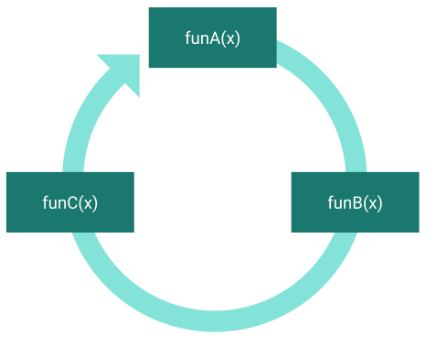
Indirect Recursion

Slide 10
Computing the Nth Fibonacci Number

Slide 11
Problem With Recursion(StackOverFlow)

Slide 12
Visualizing Tree Recursion

Slide 13
Interview Questions

Slide 14
I am who I am today because of the choices
I made yesterday

